Slide 1


KGiSL INSTITUTE OF TECHNOLOGY
COIMBATORE
DEPARTMENT OF ELECTRONICS & COMMUNICATION ENGINEERING
“ Automatic License /Number Plate Recognition ”
TEAM MEMBERS:
711721106071 NAVEEN KUMAR S
711721106097 SHANMUGAPRIYA A M 711721106103 SINDHU R 7117211060124 YOKESH K
Under the guidance of Dr. S.K MYDHILI, P/ECE

Slide 2
Agenda
Introduction
Literature Survey
Objectives
Algorithm
Proposed Block diagram
Output
Merits/Advances
Challenges Faced
Conclusion
Future enhancement
Reference

Slide 3
INTRODUCTION
The tasks of managing and using cars well, cracking theft and robbery of motor vehicles, as well as maintaining the normal order of urban transport have become increasingly heavy.
Currently, it has become an important issue for the public security department to tom static management into dynamic change management and to tumor manual management into automation.
There is an urgent need to employ an Intelligent Transportation System (ITS) so as to make effective management. ITS can perform efficient and reliable management of ambient vehicles under various circumstances.
Currently, it has become an important issue for the public security department to tom static management into dynamic change management and to tumor manual management into automation
As one of the core technologies of ITS, Vehicle Feature Recognition Technology is an important link to police enforcement systems, automated highway toll collection systems, Urban Traffic Surveillance Systems Intelligent Parking Management systems, etc
.
As one of the core technologies of ITS, Vehicle Feature Recognition Technology is an important link to police enforcement systems, automated highway toll collection systems, Urban Traffic Surveillance Systems Intelligent Parking Management systems, etc.
Thus employing image processing technology to recognize the vehicle license plate number of various kinds of vehicles is not only an important issue for information process technology but also a research issue that is of great importance in modem transportation management

Slide 4
LITERATURE SURVEY
TITLE | PUBLICATION DETAILS | METHODOLOGY/ ALGORITHMS | MERITS | DEMERITS
Automatic license plate detection and recognition system | TharaaAqaileh "OpenCV:Automatic License/Number Plate Recognition (ANPR) with Python." Publisher: Faisal Alkhateeb Year : 2023 | Detect and localize a license plate in an input image/frame. Extract the characters from the license plate Apply some form of Optical Character Recognition (OCR) to recognize the extracted character Software : Python | Additional Safety Greater safety Cost-effective | Limited accuracy Less control

Slide 5
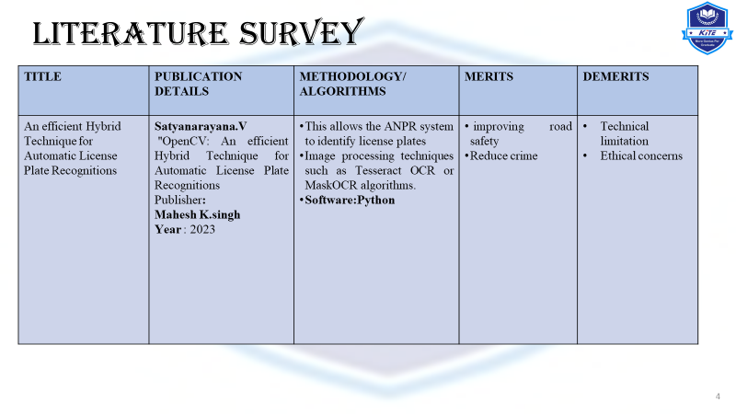

Slide 6
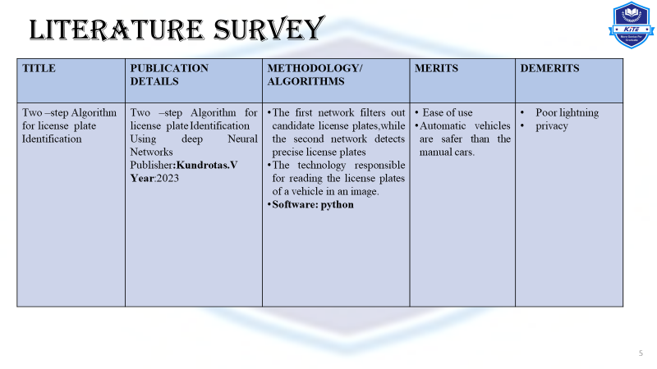

Slide 7
LITERATURE SURVEY
TITLE | PUBLICATION DETAILS | METHODOLOGY/ ALGORITHMS | MERITS | DEMERITS
A new DNN model and Bengali OCR engine for Auto- matic License Plate Recognition | A new DNN model and Bengali OCR engine for Automatic License Plate Recognition Publisher:Hussain Nyeem, Year:2021 | The analysis of total learnable parameters of the model followed by the results discussed in three main parts, namely, for vehicle detection, VLP detection and finally, for the OCR and word-mapping. Software: python | road-safety measures poor traffic management. | Poor lightning Climatic Conditions.

Slide 8
LITERATURE SURVEY
TITLE | PUBLICATION DETAILS | METHODOLOGY/ ALGORITHMS | MERITS | DEMERITS
Automatic Jordanian License Plate Detection and Recognition System Using Deep Learning Techniques | Automatic license plate detection and recognition; automatic vehicle logo detection and recognition; deep learning; transfer learning; convolutional neural network. Publisher: Tharaa Aqaileh Year:2023 | This allows the ANPR system to identify license plates. Image processing techniques such as Tesseract OCR or MaskOCR algorithms. Software:Python | Transmits real-time stamp of entry/exit of the vehicle to the database. Search and Rescue | non-uniformity of license plate number Data Variability

Slide 9
LITERATURE SURVEY
TITLE | PUBLICATION DETAILS | METHODOLOGY/ ALGORITHMS | MERITS | DEMERITS
ALPR - An Intelligent Approach Towards Detection and Recognition of License Plates in Uncontrolled Environments | Detection and Recognition of License Plates in Uncontrolled Environments Publisher:SandeepS. Udmale Year:2023 | The algorithm must have an acceptable performance and recall rate because even a small amount of missed detection will cause the LP detection process to perform worse. 2) For real-time detection to be reliable, the method must have a high calculation speed. 3) Additionally, since their use in practical applications won’t be hampered, the calculating costs should be reasonable. language:python | 24/7 operation. Real time detection and recognition process for Vehicle License Plates. 24/7 operation Reliable performance and good accuracy for different license plates. | weather conditions and obstacles.

Slide 10
OBJECTIVE
Number Plate Recognition: The code utilizes the OpenCV library along with Tesseract OCR (Optical Character Recognition) to recognize and extract text from images and video frames.
Real-Time Processing: The code is designed to process videos in real-time, frame by frame. It captures frames from the specified video file, performs number plate recognition on each frame, and writes the extracted text to Google Sheets.
Google Sheets Integration: The code integrates with Google Sheets using the gspread library and OAuth2 authentication.

Slide 11
Algorithm
Step 1: Data Collection
Gather input images or videos containing vehicles with number plates.
Step 2: Preprocessing
Read the input image or video using OpenCV (cv2).
Convert the input image to grayscale to simplify further processing.
Step 4: Number Plate Extraction
For each detected vehicle, identify the region containing the number plate.
Step 5: Easy OCR Text Recognition
Apply Easy OCR or Tesseract OCR (Optical Character Recognition) to recognize and extract text from the isolated number plate region.
Step 6: Post-processing
Cleanse and preprocess the extracted text data.
Step 7: Output
Output the extracted text to a Google Sheets spreadsheet for storage and analysis.

Slide 12
Proposed Block diagram
Traffic surveillance video camera
vechicle detection
number plate recognition
identification of vehicle number in a cloud
storing vehicle number plate data in cloud

Slide 13
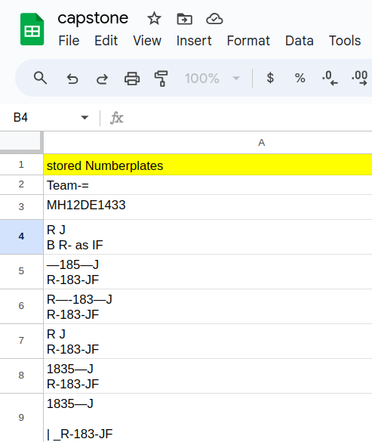
Output

Slide 14
ADVANCES/ MERITS OF PROPOSED WORK
Efficient Recognition: Uses Tesseract OCR and OpenCV for accurate recognition of alphanumeric characters.
Real-time Processing: Processes images and videos instantly, ideal for immediate identification of number plates.
Automated Logging: Integrates with Google Sheets API to automate logging, streamlining data management.
Scalable and Flexible: Scales easily for large data volumes and adapts to different environments.
Easy Integration: Modular design enables seamless integration with existing systems and workflows.
Cost-effective: Utilizes open-source libraries, reducing costs compared to proprietary solutions.
Future Development: Offers potential for integrating additional features like vehicle type recognition and analytics.
Enhanced Security: Contributes to improved security and monitoring in law enforcement, parking management, etc.

Slide 15
CHALLENGES FACED
Error Handling and Robustness: Implementing robust error handling to manage network errors, API rate limits, and unexpected failures during data logging to Google Sheets.
Integration Complexity: Managing the integration with Google Sheets API and OAuth2 authentication, handling authentication errors, token expiration, and API versioning.
Performance Optimization: Optimizing code performance to efficiently handle large video files while maintaining acceptable processing speeds and system resource usage.
Testing and Debugging: Thoroughly testing and debugging the code to identify and resolve issues related to image/video processing, text recognition, and data logging, ensuring reliable operation across diverse environments.
Handling Exceptional Cases: Gracefully handling exceptional scenarios such as incomplete or corrupted video files, missing images, and unexpected runtime errors to prevent system crashes and data loss.

Slide 16
CONCLUSION
As ANPR technology continues to advance, it is expected to play an increasingly vital role in smart cities, transportation systems, and security applications. Striking a balance between the advantages of ANPR and individual privacy protection is critical, ensuring that ANPR technology is employed responsibly and ethically. In the coming years, ANPR systems are poised to become even more integral to various aspects of our daily lives, contributing to improved efficiency and safety in a variety of contexts.
Automatic License/Number Plate Recognition (ANPR) is a technology that has revolutionized various fields, ranging from traffic management and law enforcement to security and access control. ANPR systems have proven to be invaluable tools for automating the identification and tracking of vehicles through their license plates.

Slide 17
FUTURE ENHANCEMENT
The field of Automatic License/Number Plate Recognition (ANPR) continues to evolve rapidly with advancements in technology. Future enhancements in ANPR systems are expected to address existing challenges and expand their capabilities. Here are some potential future enhancements for ANPR.
Cloud Integration: Cloud-based ANPR solutions will continue to grow, offering scalability, remote access, and data analytics capabilities. Cloud-based ANPR will be integrated with smart city infrastructure to enhance urban planning and traffic management.
Privacy Protection: As privacy concerns grow, ANPR technology will focus on privacy protection measures. Techniques like on-device processing, data anonymization, and encryption will be implemented to safeguard sensitive information.

Slide 18
REFERENCE
[1] Books:"Automatic License Plate Recognition System" by Delft University of Technology,"Automatic Number Plate Recognition on Android Platform" by Marwa F. Abdou and Hala H. Zayed.
[ 2] Adrian Rosebrock
"OpenCV: Automatic License/Number Plate Recognition (ANPR) with Python."
Publisher:pyimagesearch Year at 2021.
[ 3] Online Tutorials and Courses:OpenCV Python Tutorials: OpenCV offers a wealth of resources and tutorials on image processing and ANPR. (https://docs.opencv.org/4.x/opencv-python-tutorials.html)

Slide 19
REFERENCE
[4] OpenALPR: An open-source automatic license plate recognition library (https://github.com/openalpr/openalpr)
[5] ANPR: A Python-based ANPR system (https://github.com/krshrimali/ANPR)Vehicle Number Plate Recognition using Raspberry Pi: A project for ANPR on Raspberry Pi (https://github.com/akash-joshi/Vehicle-Number-Plate-Recognition)
[6] Research Papers and Journals:
“License Plate Recognition System Based on Deep Learning” by Yang Liu, Shuai Zhang, Minghui Wu, and Jing-Yu Yang.
“License Plate Recognition in Unconstrained Scenarios" by Zherong Pan, Chenglu Jin, and Zhong Qiu Lin in IEEE Transactions on Intelligent Transportation Systems”

Slide 20
THANK YOU

